Slide 1
C Programming
UNIT 2

Slide 2
INTRODUCTION
COMPUTER: Computer is an electronic device, which has memory and performs arithmetic and logical operations.
Input: The data entered in the computer is called input. Ex:- Keyboard, mouse, joy stick etc.,
Output: The resultant information obtained by the computer is called output. Ex:- Through Screen, Printer etc.,
Program: A sequence of instructions that can be executed by the computer is called program.
Software: A group of program to operate and control the computer is called software
Hardware: All the physical components or units of computer system connected to the computer circuit is called hardware.
Operating System: It is an interface between user and the computer. In other words, operating system is a complex set of programs, that manage the resources of a computer. Resource include input, output, processor etc., So operating system is a Resource manager.
Language: It consists of a set of executable instructions.
Package: It is designed by any other language with limited resources.

Slide 3
Continue…
Various steps involved in program or Application development:
The following steps are involved in program development.
Problem definition
Analysis and Design
Algorithms
Flow Chart
Coding and Implementation
Debugging ( errors) and testing
Documentation

Slide 4
Continue..
Problem Definition: Problem definition phase is a clear understanding of exactly what is needed for creating a workable solution. We must know exactly what we want to do before we do a problem. It involves three specifications regarding a proper definition.
• Input Specification
• Output Specification
• Processing
Analysis and Design: Before going to make a final solution for the problem, the problem must be analysed outline solution is prepared in the case of simple problems. But in the case of complex problems, the main problem is divided into sub problems called modules. These modules can be handled and can be solved independently. When the task is too big, it is always better to analyse the task, such that, it can be divided into number of modules and seek solution for each.

Slide 5
Continue…
Algorithms: Once the problem is divided into number of modules, the logic for solving each module can be developed. The logic is expressed step by step. A step by step procedure to solve the given problem is called algorithm. An algorithm is defined as a finite set of instructions which accomplish a particular task. An algorithm can be described in a natural language like English.
Flow Chart: After completion of algorithm, the program can be visualized by drawing a flow chart. A flow chart is nothing but a graphical or symbolic representation of how instructions will be executed one after another.

Slide 6
Continue…
Coding and Implementation: Coding is a process of converting the algorithm solution of flow chart in computer program. In this process each and every step of algorithm is converted to instructions of selected computer programming language.
Before selecting the programming language we must follow three considerations.
Nature of problem
Programming language available.
Limitations of computer.

Slide 7
Continue…
Debugging and Testing:-
Debugging: Before loading the program into the computer we must correct all the errors. This process is called debugging. There are three types of errors.
Syntax error
Runtime error
Logical error
Testing:- It is very important to test the program written to achieve a specific task. Testing is running the program with known data and known result.

Slide 8
Continue…
Documentation:- It is the most important aspect of programming. It is a continuous process. To keep the copy of continuous process. To keep the copy of all the phases (involving) in parts, definition, analysis and designing, algorithm, flow chart, coding and implementation, debugging and testing are the parts of the documentation. This phase involves to produce written document for the user.

Slide 9
Classification of Programming Language
Programming language can be classified into 2 types
1. High Level Language and
2. Low Level Language.
High Level Language:- Those are more English like language and hence the programmers found them very easy to learn to convert the programs in high level language to machine language compilers and interpreters are used.
Low Level Language:- All low level language called assembly language is designed in the beginning. It has some simple instructions. Those instructions are not binary codes. But the computer can understand only the machine language. Hence a converter or translator is developed to translate the low level language programs into machine language. This translator is known as Assembler.

Slide 10
Translators
Translators:- There are three types of translators available for the language.
1. Assembler
2. Compiler
3. Interpreter
1. Assembler:- This translator is used to convert the programs written in low level language(Assembly) into machine language.
2. Compiler:- Compiler is used to convert high level language into machine level language. It checks for error in the entire program and converts the program into machine language.
3. Interpreter:- This is also used to convert high level language into machine language. It checks for errors statement by statement and converts the statement into machine level language.

Slide 11
C LANGUAGE
C is a programming language it is designed by DENNIS RITCHIE in 1972 at AT & T [American Telephone and telegraphs] Bell labs in USA. C is most popular general purpose language.
BRIEF HISTORY OF C LANGUAGE:
In 1960’s COBOL was being used for commercial applications and FORTRAN for scientific and engineering applications. At this stage people started to develop a language which is suitable for all possible applications. Therefore an international committee was setup to develop such a language ALGOL 60 was released. It was not the generality a new language called CPL [Combine Programming Language] was developed at Cambridge University then some other features were added to this language a new language called BCPL [Basic combine programming language] developed by MARTIN RICHARDS at Cambridge University. Then B language was developed by KENTHOMSON at AT &T Bell labs.
DENNIS RITCHIED inherited the features of B and BCPL, added some of its own feature and developed C language in 1972.

Slide 12
Features of C Language:
C is structured programming language with fundamental flow chart constructions.
C is highly portable programming language. The programs return for one computers can be run on another with or without any modifications.
The programs return in C are efficient and fast.
C improves by itself it has several predefined functions.
C has only 32 keywords.
C supports all data conversions and mixed mode operators.
Dynamic memory storage allocation is possible with C.
C is simple and versatile programming language.
C easily manipulate with bytes, bits and address.
C has a richest of operators.
Extensive verities of da x ta types such as pointers, structures, Unions etc., available in C.
Recursive function calls for algorithmic approach is possible with C.
Mainly we are using the C language to implement the system software those are compilers, text editors, Network drives, data base utilities and finally the operating systems.
C compiler combines the capabilities of assembly level language with the features of high level language. So it is called as middle level language.

Slide 13
Important Points
C is a case sensitive programming language. C statements are entered in lower case letters only.
Every C statement must be terminated by a semicolon ( ; ) except pre-processor statements and function definition.
C is a function oriented language. Any C program contains one or more functions. Mainly one function is necessary by the name called main. Without main we cannot execute C Programs.
A function is represented by a function name with a pair of parenthesis.

Slide 14
BLOCK DIAGRAM OF EXECUTION OF C PROGRAME

Slide 15
Continue…
Once the coding is completed, the program is feed into the computer using a compiler to produce equivalent machine language code.
In C compilation two parts are there namely
Compiler and 2) Linker.
Compiler receives C source file as input and converts the file into object file. Then the linker receives that object file as input and linking with C libraries after linking it produces executable file. After creation of executable file then start the program execution and loads the information of the program in the primary memory through loading process after loading the information the processor processing the information and gives the output.

Slide 16
BASIC STRUCTURE OF C PROGRAM
Document Section: It consist the set of comment lines. The document section consists the set of comment lines giving the name of the program, author name and other details.
Link Section: It provides instructions to the compiler to link the functions from the system library.
Global Declaration Section: The variables that are used in more than one function are known as global variables and these variables are declared in the global declaration section.

Slide 17
Continue…
Main( ) Section: Every C program must have one main function this section consists two parts namely local declaration section and statement parts. The local declaration section declares all the variables used in statements. The statement part consist a sequence of executable instructions. These two parts must appear between the opening and closing curly braces. The program execution begins at the opening brace and end at the closing brace.
Sub-Programming Section: This section consists all the user defined function.
Comments: Un executable lines in a program are called comments. These lines are skipped by the compiler.
//-------------------------------- Single line comment
/*------------------------------*/ Group of lines comment

Slide 18
Continue…
Pre-Processor statements:- The pre processor is a program that process the source code before it passes through the compiler.
#include: It is a pre processor file inclusion directive and is used to include header files it provides instructions to the compiler to link the functions from the system library.
Syntax: # include “file name”
Or
#include<file name>
When the file name is included with in double quotation, the search for the file is made first the current directory and then the standard directories or the file name is included within angular bases then the file is searched only in the standard directories.

Slide 19
Continue…
Printf( “ ”): It is a function and is used to print data on the screen.
Syntax: int printf(“control sting”,[arg-1,arg-2,……..arg-n]);
Or
(format string)
The printf statement is used to print messages, the values contain in the variable on the screen.
stdio.h:- Standard input and output header file. – Printf, scanf
conio.h:-Console input and output header file. – getch, clrscr
Example: printf(“Welcome to C Programming”);

Slide 20
Continue…
Program:
#include<stdio.h>
#include<conio.h>
Void main()
{
printf(“Welcome to C Programming”);
}
clrscr():- It clears text mode window.
Syntax:- void clrscr();
getch():- It gets a character from console but does not echo to the screen.
Syntax:- int getch();
We use a getch() function in a C/ C++ program to hold the output screen for some time until the user passes a key from the keyboard to exit the console screen.

Slide 21
Continue…
Program:
#include<stdio.h>
#include<conio.h>
void main()
{
clrscr();
printf(“WELCOME TO C PROGRAMMING”);
getch();
}

Slide 22
C TOKENS
The smallest individual units or elements in a program are called tokens.
C has the following tokens…
1. Identifiers
2. Keywords
3. Constants
4. Operators
5. Special characters.

Slide 23
Continue…
1. Identifier:- Identifiers can be defined as name of the variables, arrays, functions and some other program elements using the combination of the following characters.
Alphabets: A to Z
a to z
Digits: 0 to 9
Underscore: _ ( It is usually used as a link between two words in
long Identifiers)
Note:- 1. The first character of an identifier will be an alphabet or underscore
2. The default identifier length is 32 characters.

Slide 24
Rules for constructing C identifiers
The first character of an identifier should be either an alphabet or an underscore, and then it can be followed by any of the character, digit, or underscore.
It should not begin with any numerical digit.
In identifiers, both uppercase and lowercase letters are distinct. Therefore, we can say that identifiers are case sensitive.
Commas or blank spaces cannot be specified within an identifier.
Keywords cannot be represented as an identifier.
The length of the identifiers should not be more than 31 characters.
Identifiers should be written in such a way that it is meaningful, short, and easy to read.

Slide 25
Continue…
Example of valid identifiers
total, sum, average, _m _, sum_1, etc.
Example of invalid identifiers
2sum (starts with a numerical digit)

Slide 26
Let's understand through an example.
void main() // int or void can be used as return type
{
int a=10;
int A=20;
printf("Value of a is : %d",a);
printf("\nValue of A is :%d",A);
getch();
}

Slide 27
Continue…
2. Keywords:- Keywords are the words whose meaning has all ready been explained to the compiler. That means at the time of designing a language some words are reserved to do specific tasks. Such words are called as keywords or reserve words. C has only 32 keywords.
They are
Auto | break | case | char
Const | Continue | default | extern
Float | Far | for | goto
if | Int | long | register
Return | Short | signed | sizeof
Static | Struct | switch | typedef
Union | Unsigned | void | while
Do | Double | else | enum

Slide 28
Continue…
3. Constants: Constants in C referred to fixed values that do not change during the execution of program. C supports the following constants.

Slide 29
Continue…
4. Operators:- It is a symbol which perform a particular operation.
C has a rich set of operators.
The following operators available in C are
Arithmetic Operator.
Logical Operator.
Relational Operator.
Bit-wise operator etc.,
5. Special Characters:- All characters other than alphabet and digits are treated as special symbols.

Slide 30
DATA TYPES
The kind of data that variables may hold in a programming language is called data types.
C data types can be classified into three types namely..
Primary data types
User defined data types
Derived data types

Slide 31
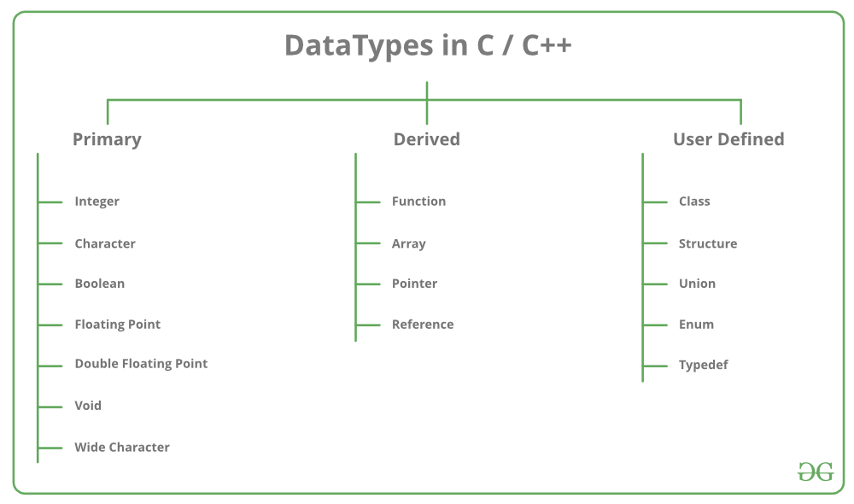
Continue…

Slide 32
PRIMARY DATA TYPES OR PRIMITIVE DATA TYPES
All C compilers supports four fundamental data types namely (int, char,, float, double).
int:- It is a positive, negative and the whole values but not a decimal number.
Example: 10,50,-25,-153,0 etc.,
char:- A single character can be treated as character data type. It is defined between single quotation (‘’)
Example: ‘a’,’H’, ‘*’,’8’ etc.,
string:- A string is a group of characters. But in C language a string is also a character data type and is defined between (“ ”) double quotation.
Example: “welcome”, “BDPS”, “abc123” etc.,
float:- The number which are stored in the form of floating point representation is known as float data type. (or) The value with decimal point./
Example: 11.53,153.2502,0.2345, etc.
double:- The number which are stored in the form of double precision floating point representation is known as double data type.
Example: 15325.437897, -2427.09987, 0.45972

Slide 33
USER DEFINED DATA TYPES
The user defined data types enable a program to invent his own data types and define what values it can taken on.
Thus this data types can help a programmer to reducing the programming errors. There are two types of user defined data types namely..
1. enum (enumerated data type)
2. typedef (type definition)

Slide 34
DERIVED DATA TYPES
The derived data types are created from the basic integers, characters and floating values.
The examples of derived data types are arrays, pointer, structures, unions, etc.,

Slide 35
Type Modifiers or Type Qualifiers (signed, unsigned, short, long)
A type modifier alters the meaning of the base data type to yield a new type. Each of these modifiers can be applied to the base type int. The modifiers signed and unsigned can also be applied to the base type char. In addition, long can applied to double.

Slide 36
Variables
Variables:- A quantity which may vary during the execution of a program is known as variable.
Declaration of a variable:- data type identifier;
(or)
data type identifier-1, identifier-2,………identifier-n;
Examples: int n;
char ch ;
float f;
int a,b,c;
Initialization:- At the time of declaring a variable we can store some data into that variable is known as initialization.
data type identifier=value;
Examples:- int n=10;
char ch=’s’;
int a=10,b=20,c=30;
int a=100,b,c=150;
Example:- int n=100;
1.printf(“%d”,n); 2.printf(“value of n=%d”,n);
output=100 output:- value of n=100

Slide 37
Continue…
Program:
#include<stdio.h>
#include<conio.h>
void main( )
{
int n=10;
clrscr();
printf(“Value of n=%d”,n);
getch();
}

Slide 38
Program: Write a program to initialize 4 standard data type variables and display initial data.
#include<stdio.h>
#include<conio.h>
Void main()
{
int n=100;
char ch=’h’;
float f=158.0962;
double d=54932.2154;
clrscr();
printf(“n=%d”,n);
printf(“\n ch=%c”,ch);
printf(“\n f=%f”,f);
printf(“\n d=%lf”,d);
getch();
}
Note:
1. In C language all declarations will be done before the first execution of programs.
2. Floating values displays 6 digits after the decimal point by default

Slide 39
Escape sequence characters
\n = new line
\t = Horizontal tab (default 8 spaces)
\v = Vertical tab (default 1 line)
\b = Back space
\r = Carriage return
\a = Alert (Beep sound)

Slide 40
String
String:- A group of characters define between double quotation marks is a string.
In C language a string is nothing but an array of characters and terminated by a null character (\0).
Syntax:- char identifier[size];
Example:- char st(20);
Initialization:- char identifier= “string”;
Example:- char st[20]= “WELCOME”;
Note:- When the compiler assigns a character string to a character array it automatically supplies a null character(\0) at the end of the string.
Therefore the size should be equal to the maximum number of characters are string+1.

Slide 41
OPERATORS
Definition:-It is a symbol which performs particular task.
Ex:- +,-,*,etc....
Operand:- It is an entity which acts on operator.
Unary operators:- The operators consists only one operand are called unary operators.
Binary operators:- The operators consists two operands are called binary operators.
C has rich set of operators.

Slide 42
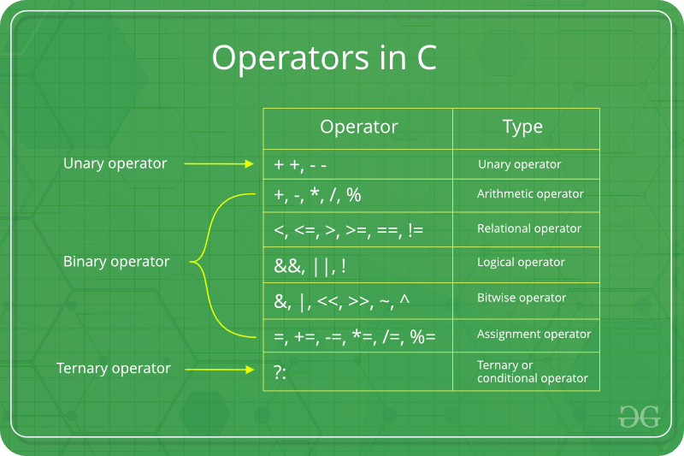
Continue…

Slide 43
Continue…
They are
1. Arithmetic operators.
2. Relational operators.
3. Logical operators.
4. Assignment operators.
5. Bit-wise operators.
6. Increment and decrement operators.
7. Special operators.
(i) ternary operator (or) Conditional operator
(ii) comma operator.
(iii) sizeof operator.

Slide 44
Arithmetical Operators
Arithmetical Operators:-These are the basic operators in C language.
They are useful for performing arithmetic calculations.
+ addition
/ division
- subtraction
% Modulus (remainder)
* Multiplication

Slide 45
Logical operators
These operators are used for combine the result of two or more expressions.
&& Logical AND
|| Logical OR
! Logical NOT

Slide 46
Continue…
Operators | Example/Description
&& (logical AND) | (x>5)&&(y<5) It returns true when both conditions are true
|| (logical OR) | (x>=10)||(y>=10) It returns true when at-least one of the condition is true
! (logical NOT) | !((x>5)&&(y<5)) It reverses the state of the operand “((x>5) && (y<5))” If “((x>5) && (y<5))” is true, logical NOT operator makes it false

Slide 47
Continue…
|| (Logical OR) operator
If one of the operands or expressions is true, it will return 1.
If all of them are false, it will return 0.
A | B | A || B | Example
0 | 0 | 0 | (5 > 10) || (5 < 4) Both expressions are false. so, logical OR output will be 0
0 | 1 | 1 | (10 > 20) || (10 < 20) First expression is false and second one is true. so, logical OR output will be 1
1 | 0 | 1 | (10 < 20) || (10 > 100) First expression is true and second one is false. so, logical OR output will be 1
1 | 1 | 1 | (10 < 20) || (10 < 100) Both expressions are true. so, logical OR output will be 1

Slide 48
Continue…
&& (Logical AND) operator
If both left and right operands or expressions are true, it will return true. Otherwise, it will return false.
Note, non-zero value operands are considered as true.
A | B | A && B | Example
0 | 0 | 0 | (5 > 10) && (5 < 4) Both expressions are false. so, logical AND output will be 0
0 | 1 | 0 | (10 > 20) && (10 < 20) First expression is false and second one is true. so, logical AND output will be 0
1 | 0 | 0 | (10 < 20) && (10 > 100) First expression is true and second one is false. so, logical AND output will be 0
1 | 1 | 1 | (10 < 20) && (10 < 100) Both expressions are true. so, logical AND output will be 1

Slide 49
Continue…
! (Logical NOT) operator
Logical NOT operator is used to inverse the current decision. Say, if current state is true, Logical NOT (!) operator will make it false.
A | !A | Example
0 | 1 | !(100 < 10) 100 is greater than 10. So, it will return false. !(false) ==> true
1 | 0 | !(10 < 100) 10 is less than 100. So, it will return true. !(true) ==> false

Slide 50
Relational operators
These are used to test the relation between two values or two variables or expressions. All c relational operators are binary operators and hence requires two operands.
< less than
> greater than
<= less than or equal to
>= greater than or equal to
= = equal to
!= not equal to

Slide 51
Continue…
Operator | Description | Example
== | Checks if the values of two operands are equal or not. If yes, then the condition becomes true. | (A == B) is not true.
!= | Checks if the values of two operands are equal or not. If the values are not equal, then the condition becomes true. | (A != B) is true.
> | Checks if the value of left operand is greater than the value of right operand. If yes, then the condition becomes true. | (A > B) is not true.
< | Checks if the value of left operand is less than the value of right operand. If yes, then the condition becomes true. | (A < B) is true.
>= | Checks if the value of left operand is greater than or equal to the value of right operand. If yes, then the condition becomes true. | (A >= B) is not true.
<= | Checks if the value of left operand is less than or equal to the value of right operand. If yes, then the condition becomes true. | (A <= B) is true.

Slide 52
Assignment operators
These are used to assign a value of an expression to an identifier.
= Assignment operator.
Compound assignment operators (or) Short hand assignment operators:-+=, -=, *=, /=, %=
Example:-int a=10;
a=a+20; (or) a+=20;

Slide 53
Continue…
Operator | Description | Example
= | Simple assignment operator. Assigns values from right side operands to left side operand | C = A + B will assign the value of A + B to C
+= | Add AND assignment operator. It adds the right operand to the left operand and assign the result to the left operand. | C += A is equivalent to C = C + A
-= | Subtract AND assignment operator. It subtracts the right operand from the left operand and assigns the result to the left operand. | C -= A is equivalent to C = C - A
*= | Multiply AND assignment operator. It multiplies the right operand with the left operand and assigns the result to the left operand. | C *= A is equivalent to C = C * A
/= | Divide AND assignment operator. It divides the left operand with the right operand and assigns the result to the left operand. | C /= A is equivalent to C = C / A

Slide 54
Continue…
%= | Modulus AND assignment operator. It takes modulus using two operands and assigns the result to the left operand. | C %= A is equivalent to C = C % A
<<= | Left shift AND assignment operator. | C <<= 2 is same as C = C << 2
>>= | Right shift AND assignment operator. | C >>= 2 is same as C = C >> 2
&= | Bitwise AND assignment operator. | C &= 2 is same as C = C & 2
^= | Bitwise exclusive OR and assignment operator. | C ^= 2 is same as C = C ^ 2
|= | Bitwise inclusive OR and assignment operator. | C |= 2 is same as C = C | 2

Slide 55
Increment and Decrement operators
These are used to control the loops in an effective method
Increment operators:- The symbol '++' is used for incrementing by 1.
Syntax:- ++identifier; (prefix increment)
identifier++; (postfix increment)
Example:- int a=10,b;
b=a++ here o/p : a=11,b=10
b=++a here o/p : a=11,b=11

Slide 56
Continue…
Decrement operators:- The symbol '--' is used for decrementing by 1.
Syntax:- --identifier; (prefix decrement)
identifier--; (postfix decrement)
Example:- int a=10,b;
b=a-- here o/p : a=9,b=10
b=--a here o/p : a=9,b=9

Slide 57
BIT-WISE operators
These are used for manipulating data at bit level they are two types:
1. Bitwise logical operators.
2. Bitwise shift operators.

Slide 58
Bit wise logical operators
These are used for the bitwise logical decision making.
& bitwise AND
| bitwise OR
^ bitwise exclusive OR

Slide 59
Bitwise shift operators
The shift operators take binary patterns and shift the bits to the left or right.
<< - left shift—is used for multiplication
12 * 2 = 12 << 1
>> - right shift—is used for division
12 / 2 = 12 >> 1

Slide 60
SPECIAL OPERATORS
Ternary operator (or) Condition operator:-
A Ternary operator is represented as "?:" It is used to construct a conditional expression. The general form of ternary operator is exp1?exp2:exp3; here exp1 , exp2 , exp3 are expressions.
If exp1 is true, then exp2 is evaluated and its value becomes the value of expression. If exp1 is false, then the exp3 is evaluated and its value becomes the value of the expression.

Slide 61
Continue…

Slide 62
Continue…
Example:
char result;
int marks;
If(marks>33)
{
result=‘p’;
}
else
{
result=‘f’;
}
char result;
int marks;
Result=(marks>33) ? ‘p’ : ‘f’;

Slide 63
CONTROL STATEMENTS (OR) CONTROL STRUCTURES
C process the decision making capabilities and supports the statements known as control statements. There are 3 types of control statements supported by C…
1.Condition control statements
2.Un condition control statements
3.Loop control statements.

Slide 64
1. Condition control statements
C supports five types of condition control statements.
Simple if statement
If else statement
Nested if statement
Else if ladder
Switch statement

Slide 65
Simple if statement:
It is a decision making statements and is used to control the flow of execution.
Syntax:-
if(expression)
{
Statements;
}
Statement2;

Slide 66
If else statements
It is an extension of simple if statement.
Syntax:- if(expression)
{
statement-1;
}
else
{
Statement-2;
}

Slide 67
else if ladder
It is also used for a serried of decisions are involved. In this statement expression are evaluated top to bottom. If the condition true, the statements associated that blocks is executed and the control transfer to the next statement. When all expressions are false, then the final else block statements will be executed.
Syntax:- if(expression-1)
{
stataement-1;
}
else if (expression-2)
{
statements-2;
}
--------------
--------------
--------------
else if (expression-n)
{
statements-n;
}
else
{
statements;
}

Slide 68
Nested if Statement
You can have if statements inside if statements, this is called a nested if.
Syntax
if( boolean_expression 1) {
/* Executes when the boolean expression 1 is true */
if(boolean_expression 2) {
/* Executes when the boolean expression 2 is true */
}
}

Slide 69
Example
#include <stdio.h>
void main () {
/* local variable definition */
int a = 100;
int b = 200;
/* check the boolean condition */
if( a == 100 ) {
/* if condition is true then check the following */
if( b == 200 ) {
/* if condition is true then print the following */
printf("Value of a is 100 and b is 200\n" );
}
}
printf("Exact value of a is : %d\n", a );
printf("Exact value of b is : %d\n", b );
getch();
}

Slide 70
Switch Statement
It is a multi way conditional statement used in c language. It is mainly used in situations where there is need to pick one alternate among many alternates.
Syntax:-
Switch (expression or variable)
{
Case value 1;
Statement1;
Break;
----------------------
----------------------
Case value n;
Statements n;
Break.;
Default;
Default statement;
}

Slide 71
Continue…
The switch statement tests the value of the given variable or expression against a list of case values and when a match is found, a block of statements associated that case is executed. Otherwise the default block statements will be executed.
The switch case statement is used when we have multiple options and we need to perform a different task for each option.
Break:- It is unconditional control statement and is used to terminate a switch statement.
Syntax :- break;
Note:-
i) In switch statement the variable or expression is an integral value.(int & char).
ii) It cannot pass string and floating values.
iii) In switch statement the default block is optional.

Slide 72
2. Unconditional control statement
1. Break (key word):- The break statement causes control to pass to the statement following the innermost enclosing while, do, for, or switch statement.
Syntax:- break; (Passes control)
2. Continue (key word):- The continue statement causes control to pass to the end of the innermost enclosing while, do or for statement, at which point the loop continuation condition in re-evaluated.
Syntax:- continue; (Passes control)
3. Goto:- The ‘goto’ statement is an unconditional control statement which is used up the execution of program sequence by transfer of control to the some other part of the program.
Syntax:- goto label;

Slide 73
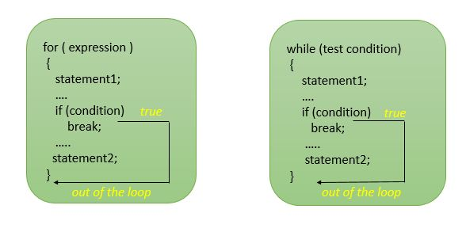
Continue…

Slide 74
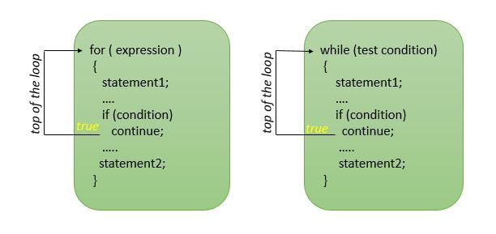
Continue…

Slide 75
Continue…
goto statement: The goto statement is a jump statement which is sometimes also referred to as unconditional jump statement. The goto statement can be used to jump from anywhere to anywhere within a function.
Syntax:
Syntax1 | Syntax2
----------------------------
goto label; | label:
. | .
. | .
. | .
label: | goto label;

Slide 76
Loop control statements
Loop:- The process of repeated executing a block of statements is called loop. C supports three types of looping statements. They are…
While Loop
do-while loop and
for-loop
Any loop has three things. They are…
1. Initialize the index
2. Test condition
3. Update the index

Slide 77
Continue…
1. while loop:- It is a conditional control loop statement in C language.
Syntax:- while(test condition)
{
Statements;
}
First the test condition is evaluated and if it is true then the statement block will be executed. After the execution of statements the test condition is evaluated once again.
Then if it is true the statement block will be executed continuous until the test condition finally becomes false.

Slide 78
Example
Write a program to check whether the given number is prime or not
#include<stdio.h>
#include<conio.h>
void main()
{
int n,i=1,count=0;
clrscr();
printf("Enter any number:");
scanf("%d",&n);
while(i<=n)
{
if(n%i==0)
count++;
i++;
}
if(count==2)
printf("Given no is prime");
else
printf("Given no is not prime");
getch();
}

Slide 79
Continue…
2. do-while loop:- It is an alternative form of while loop. The only difference between while and do while is the minimum number of execution of ‘while’ is ‘0’. For minimum no of execution of ‘do-while’ is ‘1”.
Syntax:- do
{
Statements;
}
While(test condition);
First the statement block will be executed and then test condition will be evaluated. If the condition is true then the statement block will be executed once again. This process of repeated executed continuous until the test condition finally becomes false

Slide 80
example
Write a program to accept and display natural numbers, from one to given number using do-while loop
#include<stdio.h>
#include<conio.h>
void main()
{
int n,i=1;
clrscr();
printf("Enter any number:");
scanf("%d",&n);
printf("Natural numbers form 1 to %d:\n",n);
do
{
printf("%d\t",i);
i++;
}
while(i<=n);
getch();
}

Slide 81
Continue…
3. for loop:- It is the most commonly used loop statement in C language. It consisting of three expressions.
Syntax:- for(exp1; exp2; exp3)
{
Statements;
}
The first expression is used to the initialize the index, second expression is used to check whether the loop is to be continued or not, third expression is used to change the index for further iteration (increment or decrement).

Slide 82
example
#include <stdio.h>
#include<conio.h>
void main()
{
int n, i, c = 0;
clrscr();
printf("Enter any number n:");
scanf("%d", &n);
for (i = 1; i <= n; i++)
{
if (n % i == 0)
{
c++;
}
}
if (c == 2)
{ printf("n is a Prime number");
} else
{ printf("n is not a Prime number");
}
getch(); }

Slide 83
ARRAYS
Definition:-A group of data items (variables) of same data types stored in a continuous memory location is known as arrays.
That means a group of related data items that shape location name that particular is indicated or subscript in square braces [ ] or array name.
C Supports 3 types of arrays. They are…
1.Single Dimension arrays or One dimensional
2.Double Dimension arrays or Two dimensional
3.Multidimensional arrays

Slide 84
Continue…
1. Single Dimensional array: A group of items can be given one variable name using only index such as a variable is known as single dimensional array. Single dimensional arrays the elements are represented one or two index of memory bytes.
Declaration: datatype arr_name[size];
Example: int a[5];
Elements: a[0], a[1], a[2], a[3], a[4]
In any array the array index is 0 to (n-1).
Initialization: [Form1]
Datatype arr_name[size]={value 1, value 2,…. Value b} Here size is optional
Example: int a[5]={1,2,3,4,5};
int a[ ]={100,200,300,400};

Slide 85
example
#include<stdio.h>
#include<conio.h>
Void main()
{
int a[5]={1,2,3,4,5};
int i;
clrscr();
for(i=0;i<5;i++)
{
printf("\na[%d]=%d",i,a[i]);
}
getch();
}

Slide 86
Continue…
2. Two dimensional arrays :- A two dimensional array can store a table of values which contains rows and columns .
In two dimensional arrays we use two index values. One for rows and another for columns.
Declaration:- data type arr_name[row_size][col_size];
Example:- int a[2][3];

Slide 87
Continue…
int a[2][3];
here elements:- a[0][0] a[0][1] a[0][2]
a[1][0] a[1][1] a[1][2]
Initialization :-
Form:1datatype arr_name[rowsize][colsize]={val-1,val-2,.........,val-n};
Example:- int a[2][3]={1,2,3,4,5,6};
Form:2: datatype arr_name[rowsize][colsize]={ {val-1,val-2,......},
{val-1,val-2,...val-n},{val-1,val-2,....val-n}...........};
Example:- int a[2][3]={ {1,3,4},{2,3,4} };

Slide 88
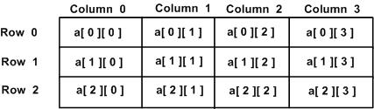
Continue…

Slide 89
example
#include<stdio.h>
#include<conio.h>
void main()
{
int a[3][3]={1,2,3,4,5,6,7,8,9};
//int a[3][3]={{1,2,3},{4,5,6},{7,8,9}};
int i,j;
clrscr();
for(i=0;i<3;i++)
{
for(j=0;j<3;j++)
{
printf("\n a[%d][%d]=%d",i,j,a[i][j]);
}
}
getch();
}

Slide 90
Continue…
3. Multi Dimensional arrays:-C supports arrays of 3 or more dimensions. In multi dimensional arrays we use more than two index values.
Syntax:- data type arr_name[s1][s2][s3]......[sn];
where s1,s2,s3,......sn are the sizes of the array.
Example:- int a[2][2][3];
here elements are:- a[0][0][0] a[0][0][1] a[0][0][2]
a[0][1][0] a[0][1][1] a[0][1][2]
a[1][0][0] a[1][0][1] a[1][0][2]
a[1][1][0] a[1][1][1] a[1][1][2]

Slide 91
Continue…
int arr[3][3][3], now it becomes a 3D array.
int shows that the 3D array is an array of type integer.
arr is the name of array.
first dimension represents the block size(total number of 2D arrays).
second dimension represents the rows of 2D arrays.
third dimension represents the columns of 2D arrays.
i.e; int arr[3][3][3], so the statement says that we want three such 2D arrays which consists of 3 rows and 3 columns.

Slide 92
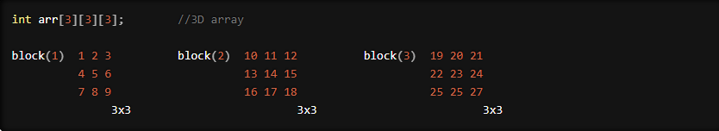
Continue…

Slide 93
Continue…
Declaring a 3D array:
To declare 3D array:
Specify data type, array name, block size, row size and column size.
Each subscript can be written within its own separate pair of brackets.
Syntax:
data_typearray_name[block_size][row_size][column_size];

Slide 94
Continue…
Ways to declare 3D array:
1). int arr[2][3][3];
2). int arr[2][3][3]={};
3). int arr[3][2][2]={0,1,2,3,4,5,6,7,8,9,3,2}
4). int arr[3][3][3]= { {{10,20,30},{40,50,60},{70,80,90}}, {{11,22,33},{44,55,66},{77,88,99}}, {{12,23,34},{45,56,67},{78,89,90}} };

Slide 95
example
#include<stdio.h>
#include<conio.h>
Void main()
{
int i, j, k;
int arr[3][4][2] = {
{ {2, 4}, {7, 8}, {3, 4}, {5, 6} },
{ {7, 6}, {3, 4}, {5, 3}, {2, 3} },
{ {8, 9}, {7, 2}, {3, 4}, {5, 1} }
};
for(i=0; i<3; i++)
{
for(j=0; j<4; j++)
{
for(k=0; k<2; k++)
printf("arr[%d][%d][%d] = %d ", i, j, k, arr[i][j][k]);
printf("\n");
}
printf("\n");
}
getch();
}

Slide 96
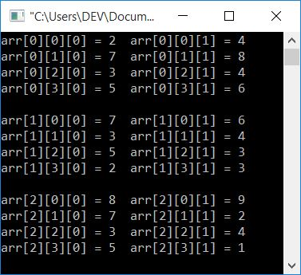
continue…

Slide 97
POINTERS
C provides the important feature of data manipulations with the address of the variables, the execution time is very much reduced such concept is possible with the special data type called Pointers.
Pointer:- A pointer is a variable which stores the address of another variable.
Declaration:-Pointer declaration is similar to normal variable declaration but preceded by a *
Syntax:- data type *identifier;
Example:- int *p;
Initialization:- datatype *identifier=address;
Example:- int n;
int *p=&n;

